Slide 1
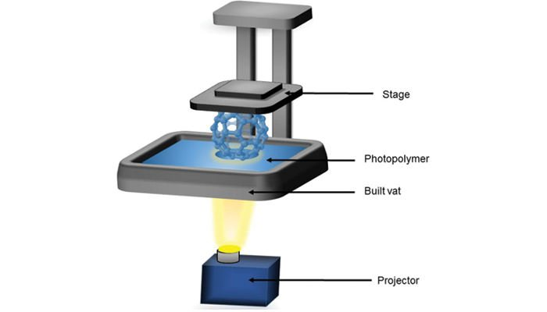
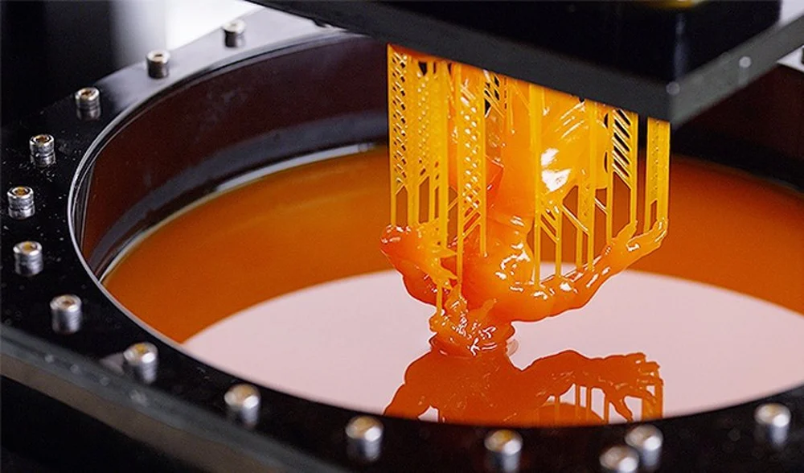
DLP
DLP uses UV light to cure resin layer by layer.
Applications: jewelry and dental.
Advantages:
Fast printing speed.
High precision and detail (50µ details).
Disadvantages:
Higher initial cost.
Expensive resin, needs careful handling.
Limited part size.

